Slide 1



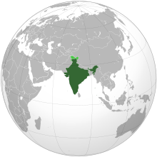


INDIAN CONSTITUTION

Slide 2
State Executive
What is a State Executive?
The government is based on the separation of powers and consists of three organs: the Legislature, Executive and the Judiciary.
The state executive is envisaged to enforce the laws made by the legislature and look after the state's governance.
The State Executive is made up of the following:
  Governor
  Chief Minister
  Council of Ministers
  Advocate General of the State
  Non-Political Permanent Executive - Civil Servants

Slide 3
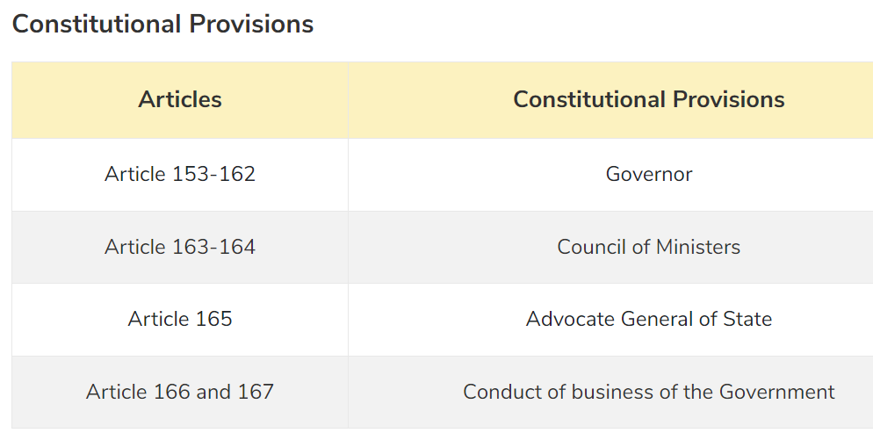
Constitutional Provisions

Slide 4
Functions
Enforcement of Laws: This is the primary function to enforce the law and maintain law and order in the state.
Policymaking: The executive is provided with the task of policymaking and developmental planning.
Functions related to Lawmaking: Since ministers are also members of the legislature they are involved in the law-making process.
Delegated Legislation: This is an additional role to make laws provided by the legislature to the executive.
Financial Functions: Though the legislature is the custodian of all the finances, the task of preparing the budgets and collection and spending of tax money is handled by the executive.
Quasi-Judicial Functions: The appointment of judges of the subordinate courts and the members of the tribunals is part of its quasi-judicial function.

Slide 5
Governor
Who is a Governor?
Governor is a nominal executive head of the state. He forms an important part of the state executive where he acts as the chief executive head. Central Government nominates the governor for each state.
Governors are the top executive officials of the twenty-eight states and are all chosen by the president of India.
The governor will have executive, legislative, financial, and judicial powers and functions

Slide 6

The Indian President appoints Governor for each state by warrant under his hand and seal. Central Government is responsible to nominate the governor for each state.
Unlike elections of the President, there is no direct or indirect election for the post of Governor.
The office of a governor is not a part of the union executive and is an independent constitutional office.
The nomination of a governor by the Union and his appointment by the President in India is based on the Canadian model of government.

Slide 7
Who is qualified to become a Governor?
Governor has to meet only two qualifications:
He should be an Indian Citizen
He should be 35 years old or more
Note: There are two conventions that the government follows before nominating a person as a Governor:
That person is not appointed as the governor who belongs to the state. He shall be an outsider having no relation with the state he is being appointed to.
Consultation of the Chief Minister is taken by the President before appointing a governor
It should also be noted that both the above conventions are not absolute and have been ignored by the union government in many instances.

Slide 8
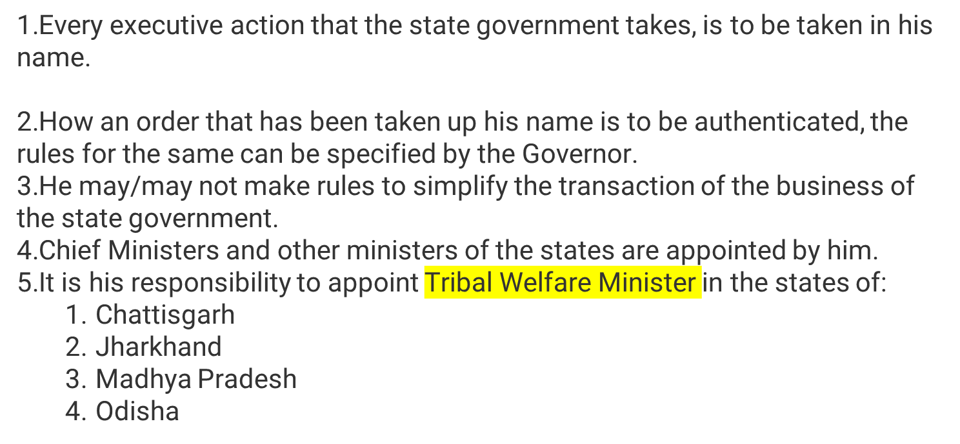
Powers and functions of the Governor
Executive Powers of the Governor

Slide 9
Executive Powers of the Governor
6.He appoints the advocate general of states and determines their remuneration
7.He appoints the following people:
  State Election Commissioner
  Chairman and Members of the State Public Service Commission
  Vice-Chancellors of the universities in the state
8.He seeks information from the state government
9.A constitutional emergency in the state is recommended to the President by him.
10.The governor enjoys extensive executive powers as an agent of the President during the President’s rule in the state.

Slide 10
Legislative Powers of the Governor
It’s in his power to prorogue the state legislature and dissolve the state legislative assemblies
He addresses the state legislature at the first session of every year
If any bill is pending in the state legislature, Governor may/may not send a bill to the state legislature concerning the same
If the speaker of the legislative assembly is absent and the same is Deputy Speaker, then Governor appoints a person to preside over the session
As President nominates 12 members in Rajya Sabha, Governor appoints ⅙ of the total members of the legislative council from the fields of:
  Literature
  Science
  Art
  Cooperative Movement
  Social Service
As President nominates 2 members in the Lok Sabha, Governor nominates 1 member in state legislative assembly from Anglo-Indian Community.
He can consult Election Commission for the disqualification of members

Slide 11
Financial Powers of the Governor
He looks over the state budget being laid in the state legislature
His recommendation is a prerequisite for the introduction of a money bill in the state legislature
He recommends for the demand for grants which otherwise cannot be given
Contingency Fund of State is under him and he makes advances out that to meet unforeseen expenditure.
State Finance Commission is constituted every five years by him

Slide 12
Judicial Powers of the Governor
He has the following pardoning powers against punishment:
  Pardon
  Reprieve
  Respite
  Remit
  Commute
President consults the Governor while appointing judges of High Court.
In consultation with the state High Court, Governor makes appointments, postings, and promotions of the district judges.
In consultation with the state high court and state public service commission, he also appoints persons to the judicial services.

Slide 13
-THANK YOU-

